Slide 1
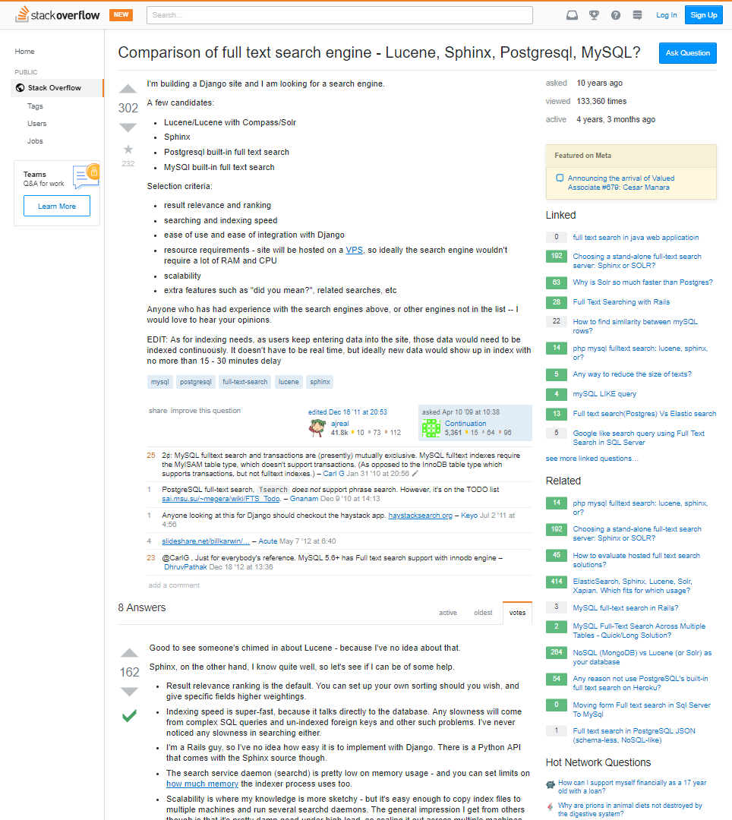
Input Data Model
Title [ String ]
Date [ Date ]
Views [ Integer ]
Tags [ String[] ]
Related Question [ String[] ]
Question
Question [ String ]
Code [ String ]
Votes [ Integer]
Comment
Comment [ String ]
Votes [ Integer ]
Answer
Answer [ String ]
Comment
Accepted Answer [Boolean]

